Slide 1
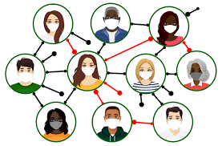
Database Design for COVID-19 Contact Tracing
Project Group 6
Mohini Patil - 015359188​
​
Shwetarani - 015277964
Samhitha Upadhyaya - 015276092

Slide 2
Introduction
Contact Tracing, a core disease control measure employed by respective health department, which is a key strategy for preventing further spread of Covid-19.
Contact tracing for Covid-19 requires to identify people who have been in contact with the infected person and monitor them.
The aim is to apply the concepts of database design and modeling to create a Contact Tracing database for Covid-19 in order to store different information related to users using contact tracing application.

Slide 3
Overview of Project
The main idea of our project is to keep track of information about people who have come in contact with the person infected by Covid-19.
The GPS location tracker is used to track the user’s location. Additionally, information about labs and tests conducted in particular cities is maintained.
Users are tracked to check if they have come in contact with an infected user based on tests conducted in a lab at a particular city.

Slide 4
Overview of Project , cont’d
Health track admin is the one who can see the information about users and they get notified if the user is infected, in a region where the health check admin holds responsibility.
The risk of having contracted Covid-19 depends on the following factors:
Individuals having medical conditions which compromises their immunity.
Individual’s travel history within a given period of time.
Individuals coming in contact with other infected person based on GPS tracking.

Slide 5
Objectives
Based on infection status and immunity compromised of users, sending an alert message to them.
Based on different Tests conducted in the lab, we want to find a list of labs that provide more than one immunity test.
Based on GPS coordinates of the users, we can identify the locations of the infected persons.
Based on the travel history and the infection status, we want to determine the country travelled by an infected person.
To find out non-infected users and their living situation who have come in contact with an infected person (CONTACT TRACING) based on GPS location.
Using infection status and address of the user we calculate the number of infected cases per city.

Slide 6
Database Initial Study
The End users of COVID-19 Contact Tracer application are users who subscribe for the application. They are regularly tracked if they have come in contact with infected persons and Health officials who analyse the data, and will notify people about whether they are at high risk of having contracted COVID-19 disease.
There should be an App user who is categorized as User and Health Track Admin
The User who is general public should be able to access the contact tracing application to fill in necessary information & get notification about his/her infection status.
The Health Track Admin should be able to access user’s data and monitor infected people within 30km radius of their location coordinates.
There should be GPS coordinates which will give the user’s location with an accuracy of 100 meters.
There should be a lab which stores the information about user’s covid-19 Test Results.

Slide 7
Database Design
The Top Down Design Approach is followed, where ER Model is designed by defining Entities and their attributes, along with relationships between different entities and Relational Schema is designed.
Defined Business rules
Developed Conceptual & Logical Model
Defined Relational Schema
Developed Physical Model

Slide 8
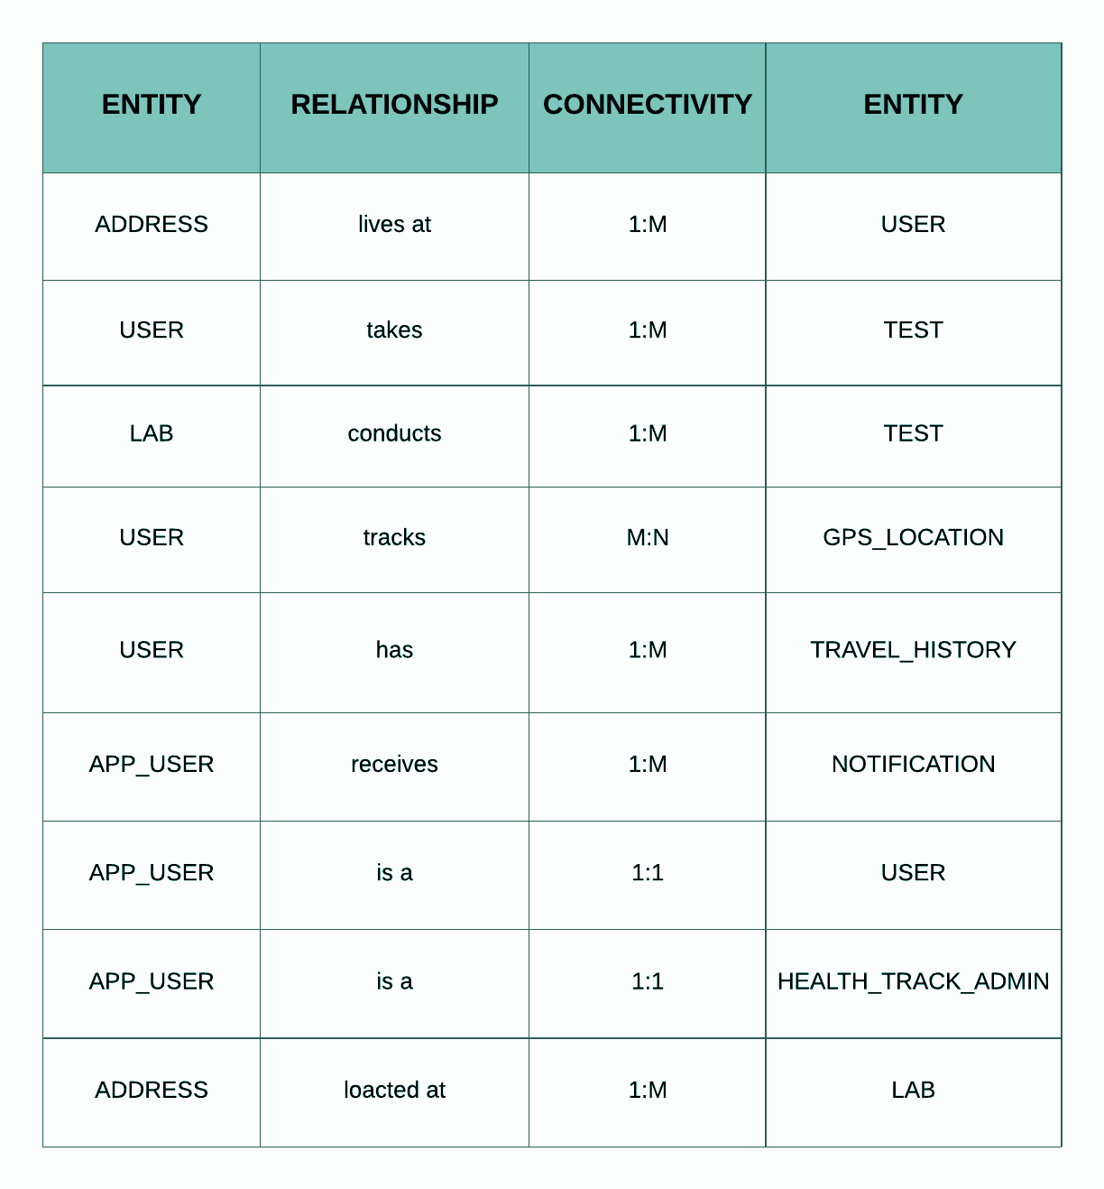
Entity Relationship Table

Slide 9
Business Rules
An APP_USER can be a HEALTH_TRACK_ADMIN and each HEALTH_TRACK_ADMIN is an app user.
An APP_USER can be a USER and each USER belongs to an app user.
Each USER can have one address and each ADDRESS belongs to many users.
Each USER can take many tests and each TEST is carried out on a particular user.
A Lab can conduct many tests and each TEST is carried out in one lab.
Each USER can have many tracking GPS locations and each GPS location is tracked by many users.
Each USER can have many travel histories and each TRAVEL HISTORY belongs to one user.
An APP_USER can receive many notifications about his risk of contracting COVID-19 and each NOTIFICATION is received by one app_user.
Each LAB is located at a particular address and each ADDRESS belongs to many labs.

Slide 10
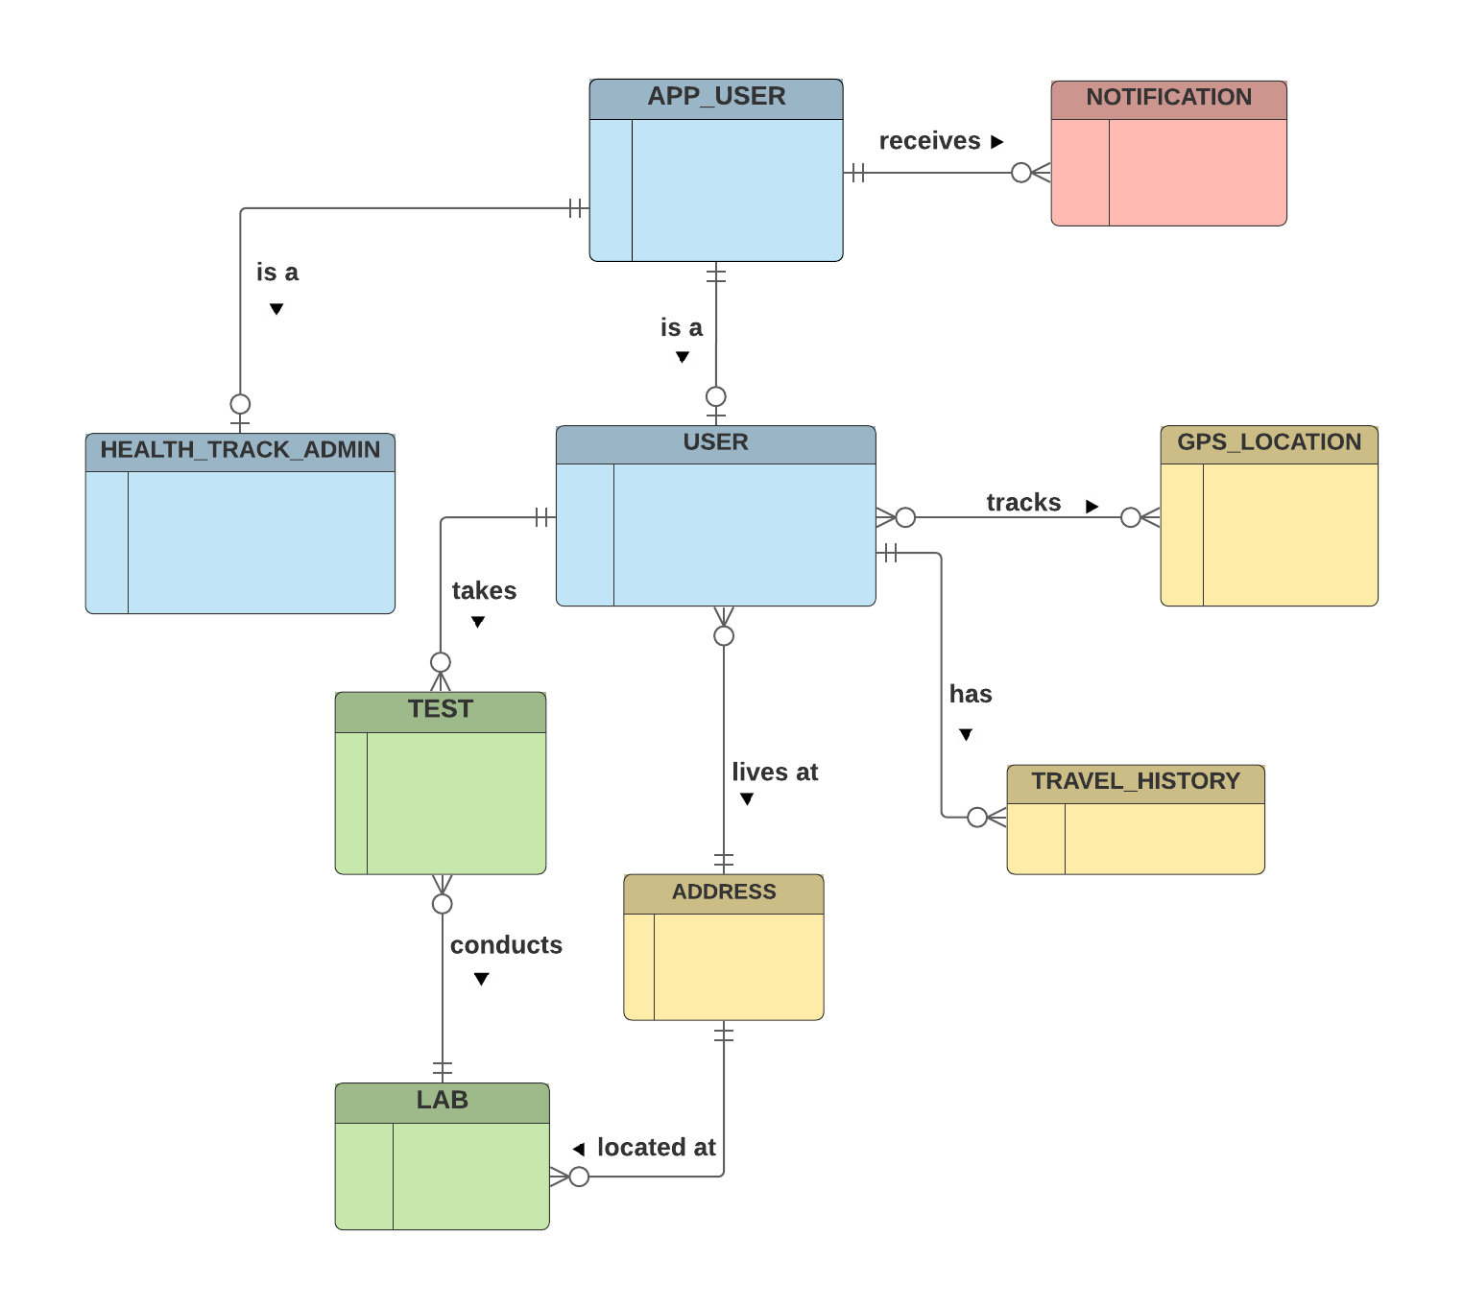
Conceptual Model
The Conceptual Design is a high-level design process which involves describing entities, relationships for COVID-19 Contact Tracer Database.
Defining all the entities.
Defining relationships between entities.

Slide 11
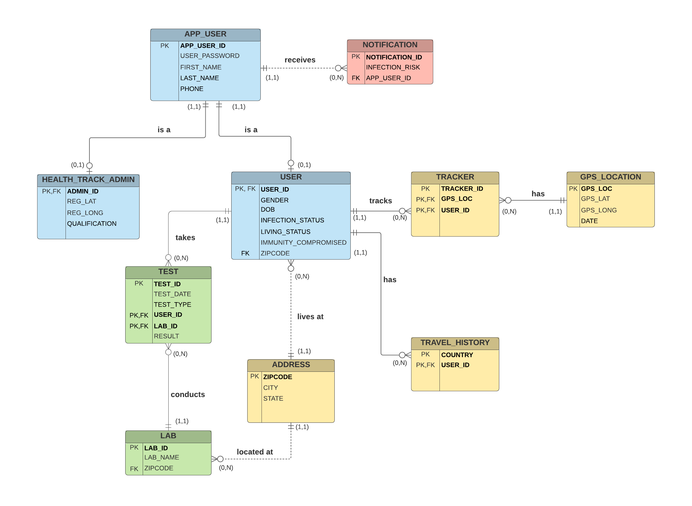
Logical Model
The logical data model adds further information to
the conceptual data model elements.
Defined all attributes for the entities, identified
Primary keys & Foreign keys.
Defining all the relationships, cardinalities between entities.
Converting M:N relationships to 1:M
Identified strong and weak relationships.

Slide 12
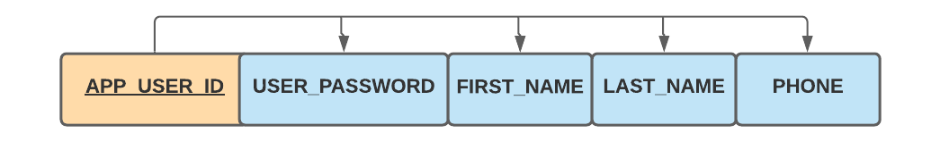
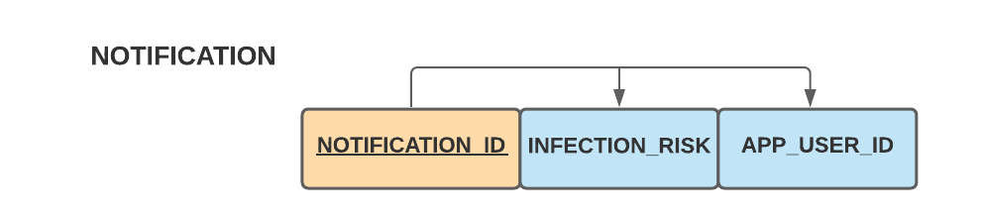
Proof using functional dependencies to show that our tables are in 3NF( 3rd NORMAL FORM)
APP_USER
APP_USER_ID --->{USER_PASSWORD , FIRST_NAME, LAST_NAME, PHONE}
NOTIFICATION
NOTIFICATION_ID ---> {INFECTION_RISK , APP_USER_ID}

Slide 13
Relational Schema
APP_USER(APP_USER_ID, USER_PASSWORD, FIRST_NAME, LAST_NAME, PHONE)
HEALTH_TRACK_ADMIN (ADMIN_ID, REG_LAT, REG_LONG, QUALIFICATION)
USER (USER_ID, GENDER, DOB, INFECTION_STATUS,LIVING_STATUS,IMMUNITY_COMPROMISED, ZIPCODE )
GPS_LOCATION(GPS_LOC,GPS_LAT,GPS_LONG,DATE)
ADDRESS (ZIPCODE, CITY, STATE)
LAB (LAB_ID, LAB_NAME, ZIPCODE)
TEST (TEST_ID, TEST_TYPE, TEST_DATE,USER_ID, LAB_ID, RESULT)
NOTIFICATION(NOTIFICATION_ID,INFECTION_RISK,APP_USER_ID)
TRACKER( TRACKER_ID, GPS_LOC,USER_ID)
TRAVEL_HISTORY (COUNTRY, USER_ID)

Slide 14
Constraints
The translation of the conceptual model into a logical model also requires a definition of the attribute domains and appropriate constraints.
Primary key should be unique and not null
User should have Unique Phone Number
Infection Status:{infected,suspected,not infected}
Living Status:{group,isolated}
Infection Risk:{high,low}
Test Type:{Antibody,RT-PCR}

Slide 15
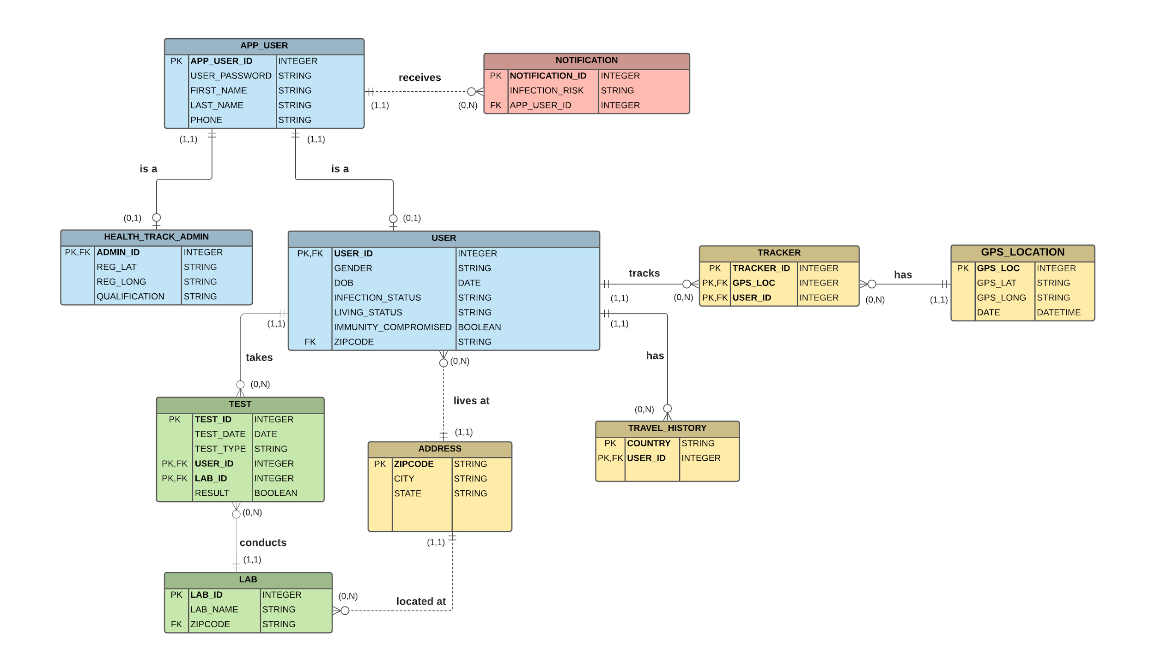
Physical Design
A physical data model represents relational data objects
and used to generate DDL statements.
Defined table names, column names, column constraints
Defined attribute data types, primary key, foreign key for table
Security and Access control:
Database owner can perform all the configuration and maintenance activities on the database.
Database admin can have CREATE , READ , UPDATE and DELETE access.
Data analysts can only have access to read the table’s data which means, he has granted access to SELECT on Database.
Application user can have only write access to the database, they can only enter the data.
Health_Track_Admin can have access to user’s information

Slide 16
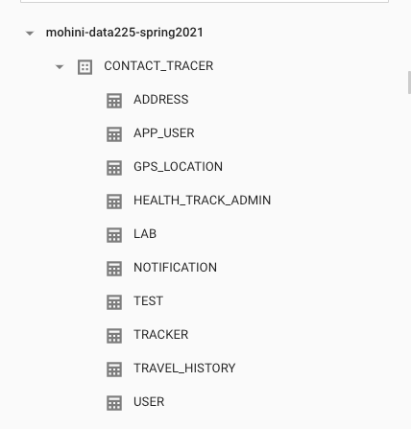
DBMS Selection - BigQuery
BigQuery works great with all sizes of data up to several Petabytes.
As our database design is for contact tracing mobile applications, if the popularity of the application grows, BigQuery can handle large amounts of data easily and also we can analyze data in BigQuery.
By using Physical design, we created all the tables and loaded data by using generatedata.com

Slide 17
Testing & Evaluation
Testing and Evaluation using CRUD operations.
C: CREATE - In this operation, we usually test for creating or inserting values into a table.
R: RETRIEVE - This operation is for finding or retrieving information from the database. (i.e SELECT)
U: UPDATE - UPDATE operation takes place, While doing Edit or Modifying an existing record.
D: DELETE - This operation is used to delete the existing record.

Slide 18
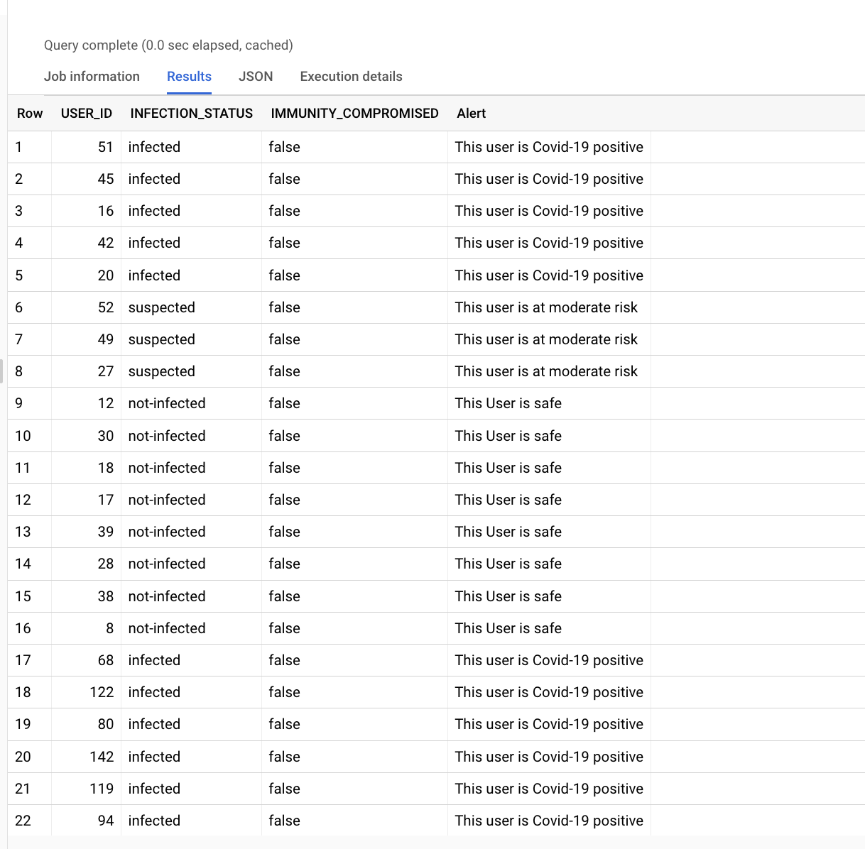
Queries (Query Statements defined for Objectives)
Using SELECT CASE/WHEN, based on infection status and immunity compromised of users, sending an alert message to them.
SELECT USER_ID, INFECTION_STATUS, IMMUNITY_COMPROMISED,
CASE WHEN INFECTION_STATUS = 'suspected' AND IMMUNITY_COMPROMISED = TRUE
THEN 'This user is at high risk'
WHEN INFECTION_STATUS = 'suspected' AND IMMUNITY_COMPROMISED = FALSE
THEN 'This user is at moderate risk'
WHEN INFECTION_STATUS = 'infected'
THEN 'This user is Covid-19 positive'
WHEN INFECTION_STATUS = 'not-infected' AND IMMUNITY_COMPROMISED = TRUE
THEN 'This user is at low risk'
ELSE 'This User is safe'
END AS Alert
FROM CONTACT_TRACER.USER

Slide 19
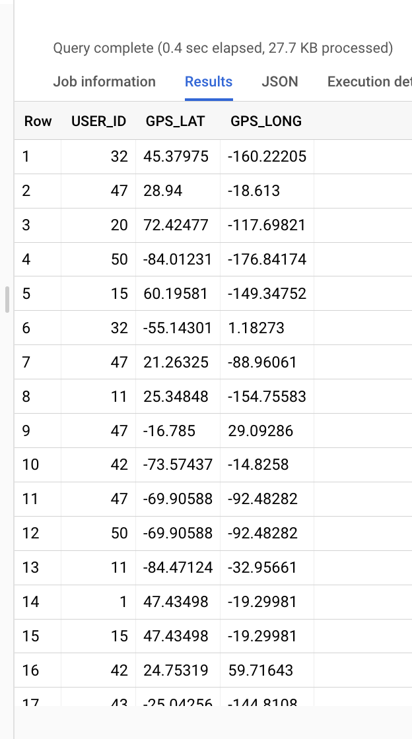
Queries, cont’d
Identify the GPS coordinates of the infected person
SELECT U.USER_ID, G.GPS_LAT, G.GPS_LONG
FROM `mohini-data225-spring2021.CONTACT_TRACER.GPS_LOCATION` AS G
INNER JOIN `mohini-data225-spring2021.CONTACT_TRACER.TRACKER` AS T
ON G.GPS_LOC = T.GPS_LOC
INNER JOIN `mohini-data225-spring2021.CONTACT_TRACER.USER` AS U
ON T.USER_ID = U.USER_ID
WHERE U.INFECTION_STATUS = "infected"

Slide 20
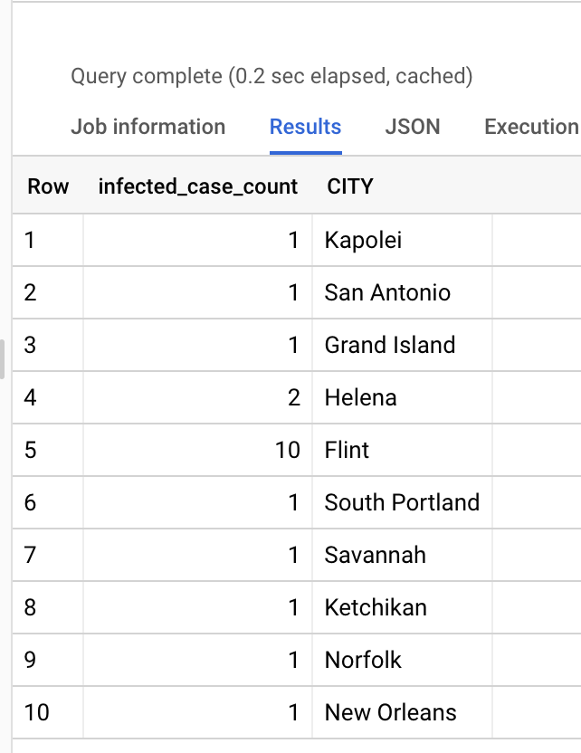
Queries, cont’d
Number of infected cases per city
SELECT COUNT(U.USER_ID) AS infected_case_count, A.CITY
FROM CONTACT_TRACER.USER AS U
INNER JOIN CONTACT_TRACER.ADDRESS AS A
ON U.ZIPCODE = A.ZIPCODE
WHERE U.INFECTION_STATUS = 'infected'
GROUP BY A.CITY

Slide 21
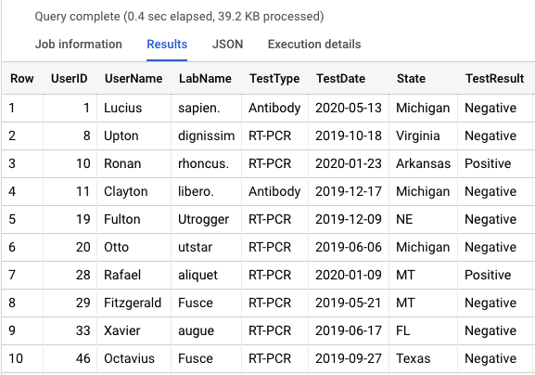
View
Created a view to display the user’s test information like which test user took from which lab and the result of that test.
CREATE VIEW CONTACT_TRACER.USERDATA AS(SELECT USER.USER_ID AS UserID,APP_USER.FIRST_NAME as UserName,LAB.LAB_NAME AS LabName, TEST.TEST_TYPE AS TestType , TEST.TEST_DATE as TestDate, ADDRESS.STATE as State,
CASE WHEN TEST.RESULT = False THEN 'Negative'
ELSE 'Positive'
END AS TestResult
FROM CONTACT_TRACER.USER , CONTACT_TRACER.TEST , CONTACT_TRACER.LAB,CONTACT_TRACER.ADDRESS,CONTACT_TRACER.APP_USER
WHERE LAB.LAB_ID= TEST.LAB_ID AND
TEST.USER_ID = USER.USER_ID AND
USER.ZIPCODE=ADDRESS.ZIPCODE AND
USER.USER_ID=APP_USER.APP_USER_ID
ORDER BY UserID);

Slide 22
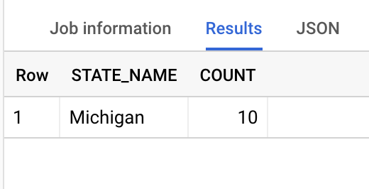
Stored Procedure
Created a stored procedure to get the number of infected cases for particular state.
CREATE OR REPLACE PROCEDURE CONTACT_TRACER.GetCovidCases (IN STATE_IN STRING, OUT COUNT INT64)
BEGIN
SET COUNT = (SELECT COUNT(U.USER_ID)
FROM CONTACT_TRACER.USER AS U
INNER JOIN CONTACT_TRACER.ADDRESS AS A
ON U.ZIPCODE = A.ZIPCODE
WHERE U.INFECTION_STATUS = 'infected' AND
A.STATE = STATE_IN
);
END;
DECLARE COUNT INT64;
DECLARE STATE_NAME STRING DEFAULT 'Michigan';
CALL CONTACT_TRACER.GetCovidCases(STATE_NAME, COUNT);
SELECT STATE_NAME, COUNT

Slide 23
Conclusion
The proposed system will help in controlling the spread of COVID-19 disease when implemented as a complete system i.e COVID-19 contact Tracing .
To create the Contact Tracing Database, first we analyzed the situation, we defined business rules and designed models, then loaded the data into the database and then tested and evaluated.
The proposal states that by using simple applications one can create a public health monitoring system. In conclusion, we believe that implementing such a database system will automate the process of Contact Tracing.

Slide 24
Future Work
The database designed for COVID-19 Contact tracing can be used for generic contact tracing and for other analytical use cases as well.
In addition, people surveys can be conducted for users where they are asked to update about their symptoms, body temperature which can then be used as added information to track people infected with disease.

Slide 25
THANK YOU

